Slide 1

Analysis of COVID-related Stress

Slide 2
Overview
Stress: the feeling of being overwhelmed and unable to cope with pressure
Potential to exacerbate various diseases in the long term²
Affects everyone, but response is individual¹
Jacoby R, Greenfeld Barsky K, Porat T, Harel S, Hanalis Miller T, Goldzweig G. Individual stress response patterns: Preliminary findings and possible implications. PLoS One. 2021;16(8):e0255889. Published 2021 Aug 13. doi:10.1371/journal.pone.0255889
Agnvall, E. (n.d.). Stress and Disease—Conditions that May Be Caused by Chronic Stress. AARP. Retrieved December 3, 2021, from https://www.aarp.org/health/healthy-living/info-2014/stress-and-disease.html

Slide 3
Data
SAD: A Stress Annotated Dataset³
Collected before COVID and during the initial months of the pandemic
Collection of texting-like sentences from chat bots and web scraping
Article & GitHub
Each sentence given a stress severity score and a label
Mauriello, M. L., Lincoln, T., Hon, G., Simon, D., Jurafsky, D., & Paredes, P. (2021). SAD: A Stress Annotated Dataset for Recognizing Everyday Stressors in SMS-like Conversational Systems. Extended Abstracts of the 2021 CHI Conference on Human Factors in Computing Systems, 1–7. https://doi.org/10.1145/3411763.3451799
Notes:
-data set creators’ own prototype chatbot and livejournal entries
-creators crowdsourced workers to vote for a label and scale the severity of the sentence. label assignment was based on a majority vote and severity score based on average score

Slide 4
Data
Emotional Turmoil
Everyday Decision Making
Family Issues
Financial Problem
Health, Fatigue, or Physical Pain
School
Social Relationships
Work
Other
Mauriello, M. L., Lincoln, T., Hon, G., Simon, D., Jurafsky, D., & Paredes, P. (2021). SAD: A Stress Annotated Dataset for Recognizing Everyday Stressors in SMS-like Conversational Systems. Extended Abstracts of the 2021 CHI Conference on Human Factors in Computing Systems, 1–7. https://doi.org/10.1145/3411763.3451799
Notes:
Other: consists of stressors that cannot be easily tied to the other broad categories, like politics

Slide 5
Analysis
Is there a difference in stress severity between stress related and unrelated to COVID?
Were there any differences between the stressors overall?

Slide 6
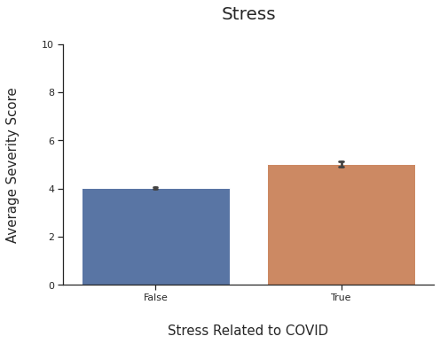
STRESS Related to covid
T-test:
H₀: No difference between the means of severity
H_{a}: There is a difference between the means of severity
Results:
alpha = 0.05
p-value = 3.58 x 10⁻⁵⁰

Slide 7
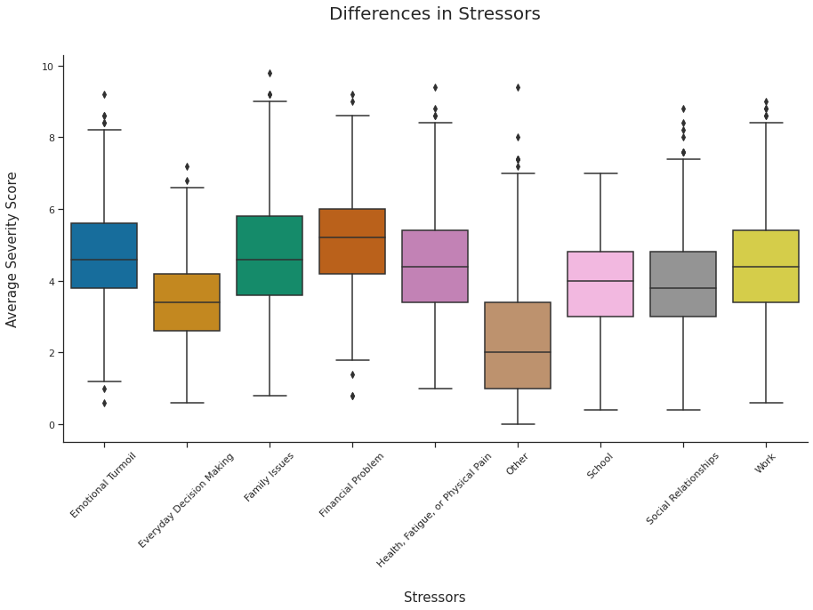
Differences Between Stressors
Kruskal-Wallis test
alpha = 0.05
p-value = 7.07 x 10⁻³¹¹
Dunn test
alpha = 0.05
Everyday Decision Making
Financial Problem
Other

Slide 8
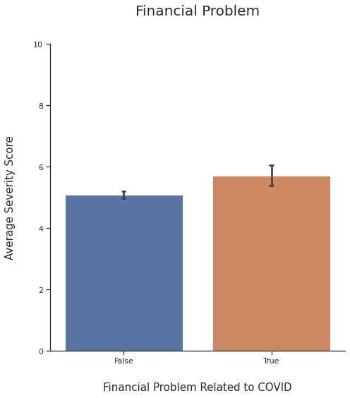
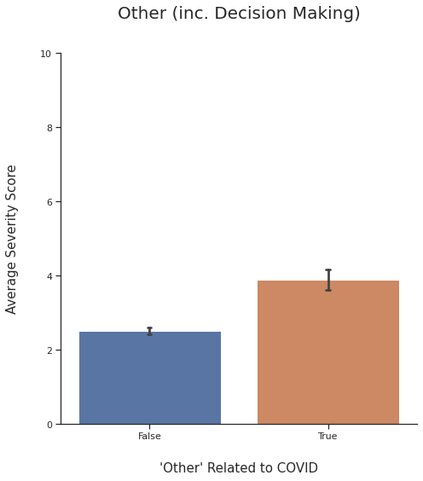
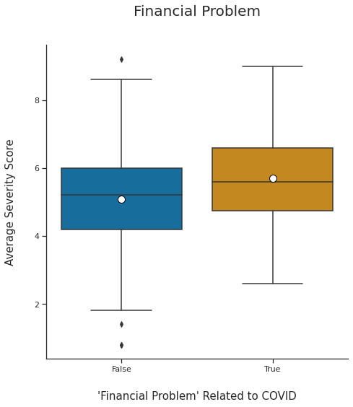
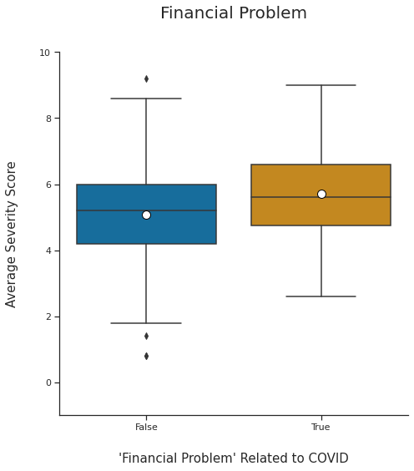
Differences Between Stressors
T-test
Financial Problem
alpha = 0.05
p-value = 5.57 x 10⁻⁴
Other (inc. Decision Making)
alpha = 0.05
p-value = 1.20 x 10⁻¹³

Slide 9
Conclusions
Increase in average stress severity when stress is related to COVID
Stressors may have differing severities
Financial Problems, Everyday Decision Making, and Other in relation to COVID

Slide 10
Going Further
Creators of the data set mentioned future use in chatbots
More data needed to provide robust training set
Data collection following the same methods can be used in workplaces, schools, and other settings

Slide 11

Thanks for listening!
(Questions?)

